Slide 1
SHRI VISHNU ENGINEERING COLLEGE FOR WOMEN::BHIMAVARAM (AUTONOMOUS) DEPARTMENT OF CSE Academic Year:2020-2021 Mini project-1 batch no. :c-14 project title: Quizzee -A quiz application

Slide 2
GUIDE NAME : PRESENTED BY:
Ms. RV Swathi T.Vyshnavi-19B01A05H2
Y. S. V. Anitha-19B01A05I8
P.Lohitha-19B01A05D6
T.S.Prasanna-19B01A05H4
G.Swarna-19B01A05E8
P. Eekshitha Sri-19B01A05D1

Slide 3
OBJECTIVES AND REQUIREMETS

Slide 4
introduction:
In today’s world , Smart phones have changed our lives and have become an indispensable part of our lives because of its specialty to simplify our routine work and thereby saving our time.
A smartphone with android OS offers excellent functionality to the users offering a distinct experience. There are tons of applications available and one of the prime reasons for this vast number is android being an open source.
In this context , project application is developed based on android platform. Our project title is QUIZZEE .
Aim of this project is to develop android platform that supports quiz application named QUIZZEE.

Slide 5
Project Introduction:
Objective:-
Creating an android application through which students can test for their exam preparation.
Project Context:-
The quiz format for an examination has been a standard since a long time and still persists to be. The reason for the same will be the efficiency and feasibility it carries with it. Our application is a simple real-world android application where students can take their test in quiz format. The application is developed using kotlin and integrated with Firebase.

Slide 6
Objectives of application:
Primary goals
Create a login page for user.
Create a home page for admin(provided by firebase) through which they can upload questions for a new quiz
Add functionalities like add questions, delete questions for Admin.
Create a home page for students where they can view available quizzes, so that they have the opportunity to participate in those quizzes.
Add functionalities like see reports of attempted including scores for students.

Slide 7
FUNCTIONALITIES

Slide 8
The system will maintain different subjects for quizzes
While entering the question the admin will be able to select the right answer for the question entered.
The application will be able to evaluate each question by comparing its correct answer.
The admin will be able to edit or delete a question.
Admin will be able to declare the result of quiz which will be made available to the users after the submission of quiz.
User will be able to login/logout.
User will be able to start the quiz
User will be able to end the quiz
User will be able to select a single option from the list.
User will be able to skip a question for later attempt.
User will be able to see the attempted and non-attempted questions.

Slide 9
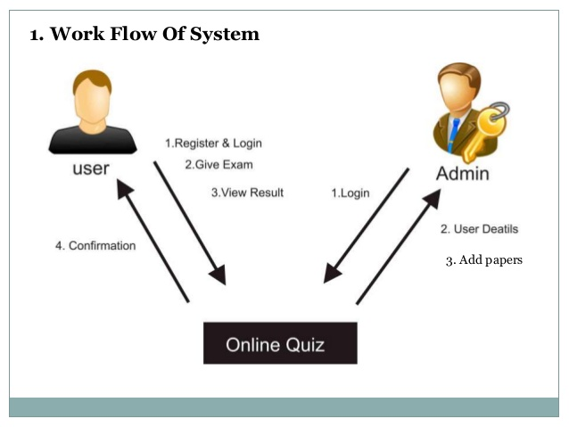
QUIZ

Slide 10
Existing system
The existing system is the manual one in which users are maintaining books or papers to attempt MCQ tests.
And the papers are corrected manually by respective faculty which needs time.
The information regarding student details , instructor details schedule details are stored in books which are difficult to maintain.

Slide 11
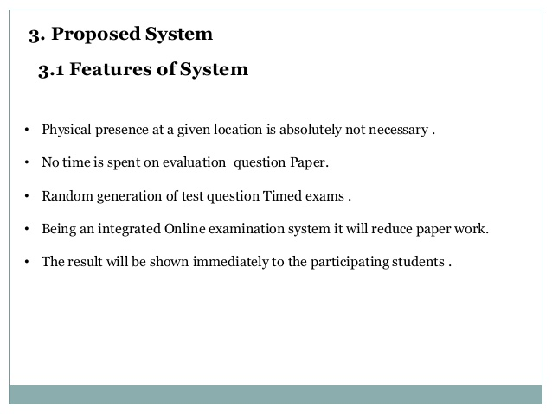
Proposed system

Slide 12
Domain knowledge
Kotlin
Data Base(No SQL)
XML files
Android studio

Slide 13
Software requirements
Operating System-supportive for java
Java JDK or JRE 1.6 or higher
Android studio
Firebase
Supported Fire Base Database and that supports the database connection with kotlin.

Slide 14
Hardware requirements:
Minimum Windows 95 software
Hard Drive and Minimum of 8 MB memory
A CD-ROM drive
Mouse, keyboard and sound card, if required
Microsoft® Windows® 7/8/10 (64-bit)
4 GB RAM minimum, 8 GB RAM recommended.
2 GB of available disk space minimum, 4 GB Recommended (500 MB for IDE + 1.5 GB for Android SDK and emulator system image)
1280 x 800 minimum screen resolution.

Slide 15
MODULES

Slide 16
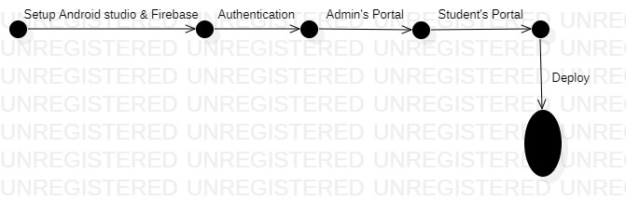
Project Stages:
The project consists of the following stages:1.Environment setup
2.Authentication by firebase
3.Admin’s portal by firebase
4.Student’s portal

Slide 17
1.Environment & Firebase setup
Before the start of any development procedure, we need to set up the environment according to our application needs. Then connect our Android Studio with Firebase .
Requirements
Install Android Studio on your machine.
Install and set up JDK.
Create new Android project.
Like any typical application, the source code of java or kotlin should be in a java folder and the source code of xml should be in a res folder .
Connect with firebase.

Slide 18
2.Setting up Firebase and Authentication
Firebase is a service provided by Google for configuring the backend of any application with all the general necessities like database preparation, authentication using various methods, etc. In this milestone, we’ll be preparing our database and setting up authentication using email and password.
Requirements
Setup sign-in method using Email/Password.
Declare the dependency for the Firebase Authentication Android library in your module ( app-level ) Gradle file ( usually app/build. gradle ).
To use an authentication provider, you need to enable it in the Firebase console. Go to the Sign-in Method page in the Firebase Authentication section to enable Email/Password sign-in and any other identity providers you want for your app.
Android has Material components, which helps in building our frontend.
Create a new activity named Login . Style the activity as you like.

Slide 19
3. Admin’s portal
The admin portal is provided by google firebase
So admin can check the user details
And admin can add or delete users
b)Creating quiz activity
This portal is also provided by google firebase through cloud firestore
this is no SQL database
Add the necessary code in the xml and kotlin files so that all the work is done accurately as mentioned earlier

Slide 20
4. Student's portal
a) Home activity
Now we will create an activity where there will be another two options: Available Quizzes and menu option.
The available quiz option allows students to participate in available quizzes.
In the menu section, students will be able to see their profile . Students will be able to logout .
Style the activity as you like.
b)Quiz activity
After choosing any one of the available quizzes in Home Activity , a student will able to take that quiz.
c)Reports/results/Confirmation activity
Now we will create a progress activity through which students can see the results of their quiz here.
Requirements:
Add the necessary code in the xml and java file so that all the work is done accurately as mentioned earlier.

Slide 21
SYSTEM DESIGN

Slide 22
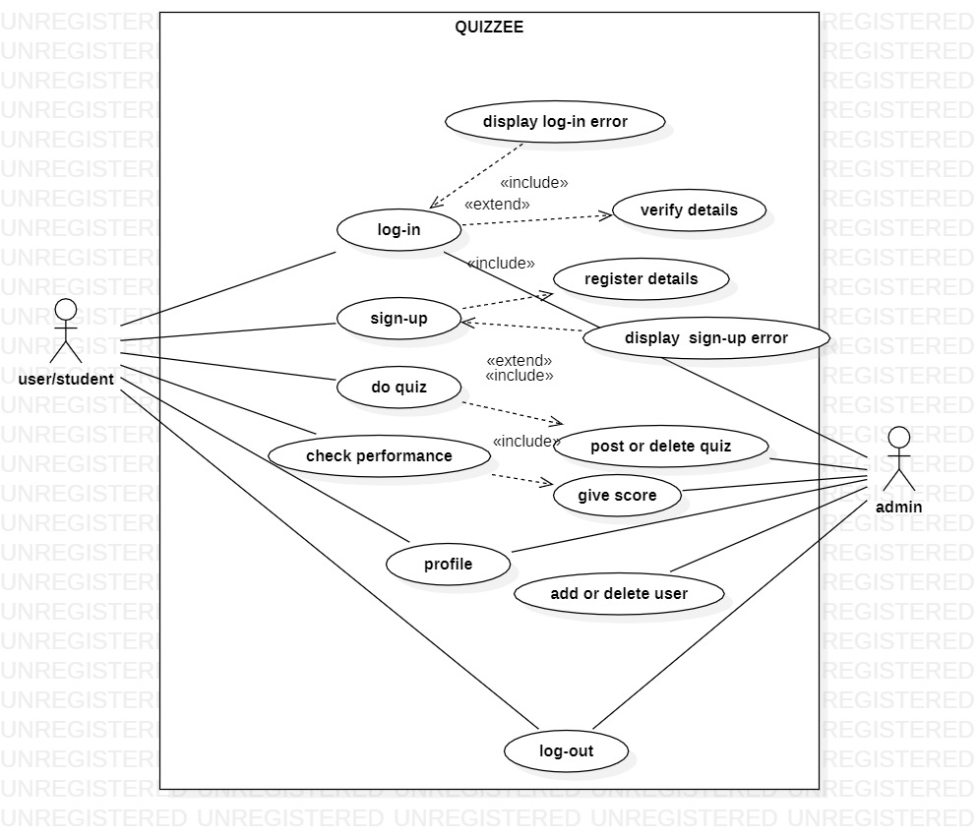
Use Case diagram

Slide 23
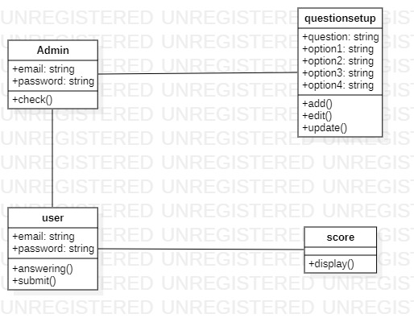
Class diagram

Slide 24
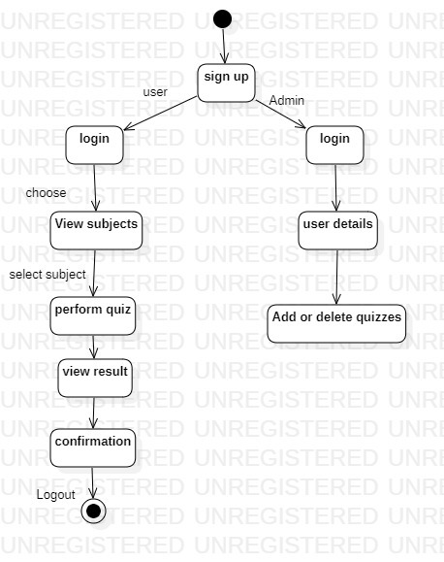
State chart Diagram:

Slide 25
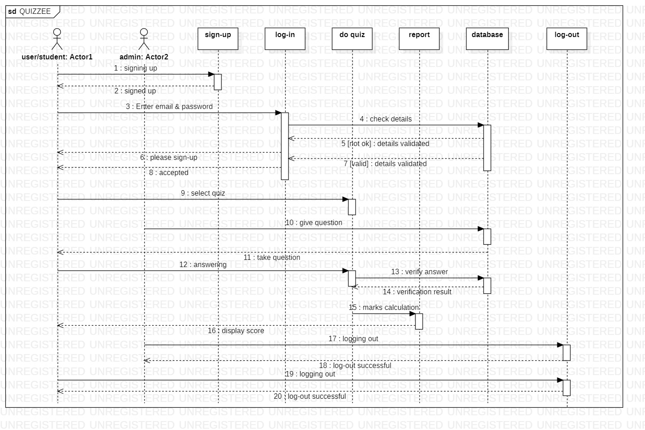
Sequence diagram

Slide 26
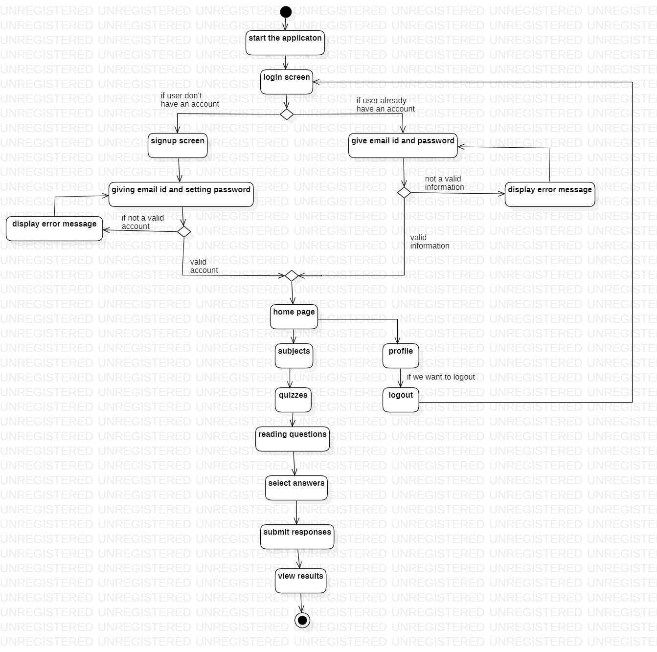
Activity diagram

Slide 27
System implementation

Slide 28
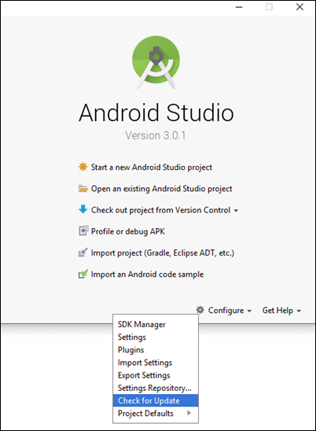
Environment setup:
Install ANDROID STUDIO, after installing it we create a new project. And we connect it to the firebase available in tools option of Android studio.

Slide 29
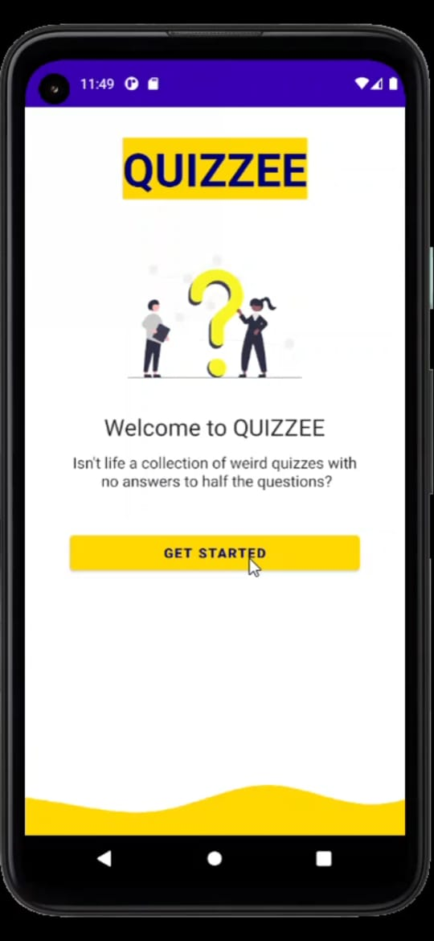
Open the application then we have an Intro page to our project.
For login we click on get started button appeared in Intro page as shown adjacent.

Slide 30
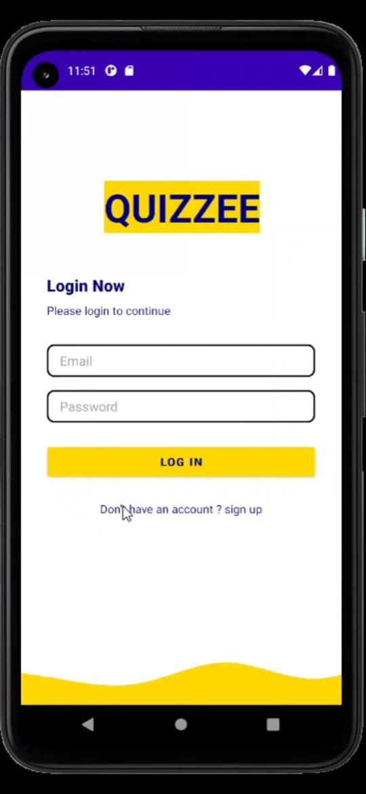
Authentication:
If at all we don’t have an account in that application
As shown in below pic we should sign up first
After clicking the Get Started the page will be directed to login page. It will ask an Email ID and password.
Provide email ID and password
After click on login button
Then application communicate with server and verify whether the provided email ID and password is correct or not
If provided Information found at server end and match with the ‘user’ then page will be direct to home page

Slide 31
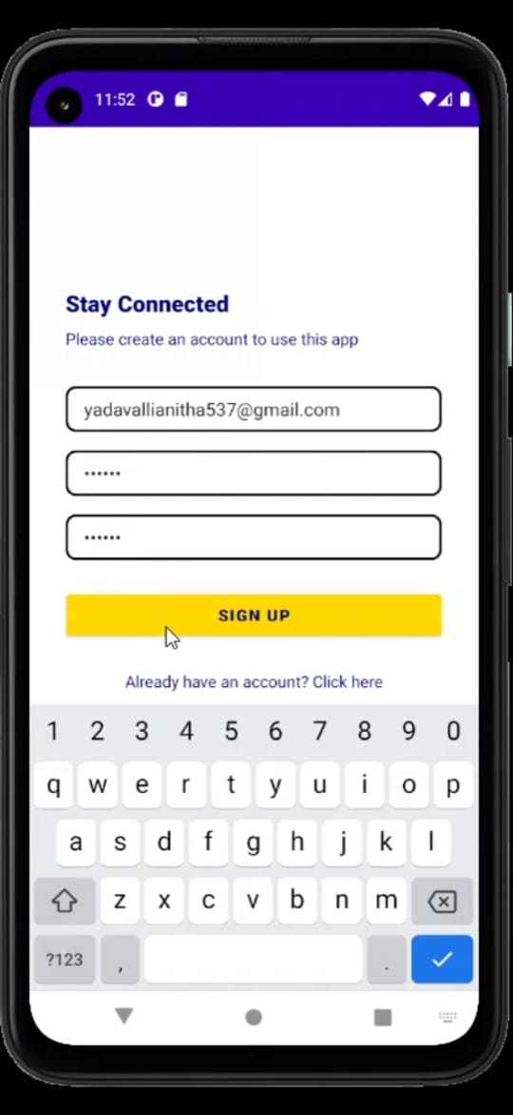
For that we should give a proper email ID and we will give password then we create an account After signing up, the page will be directed to home page

Slide 32
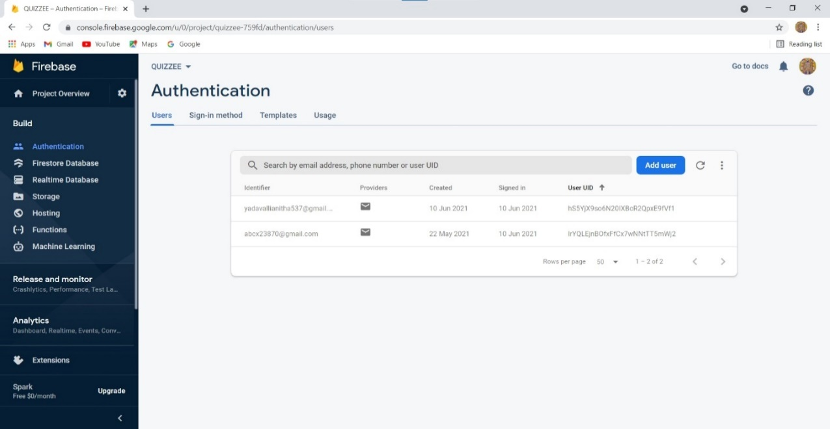
Admin’s portal:
Admin can check user details
Remove or add users

Slide 33
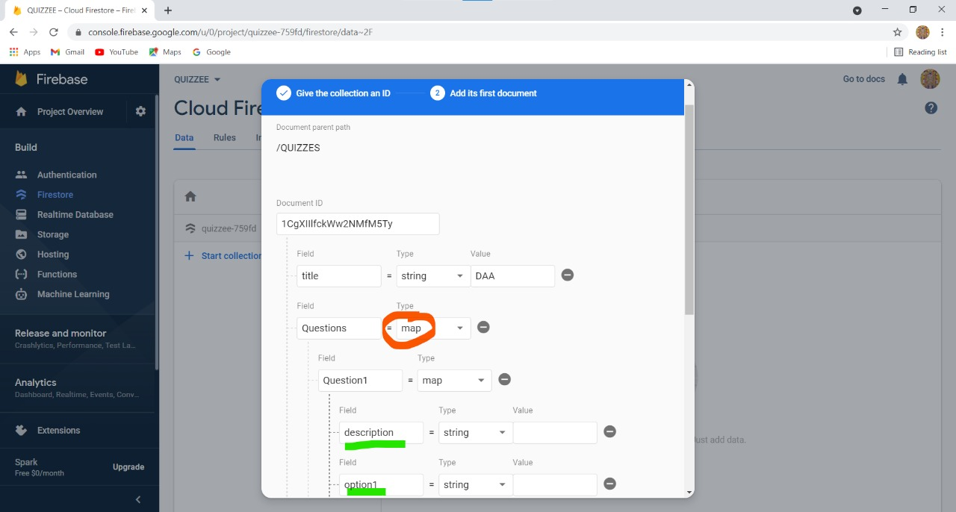
Add update or delete questions in each collection

Slide 34
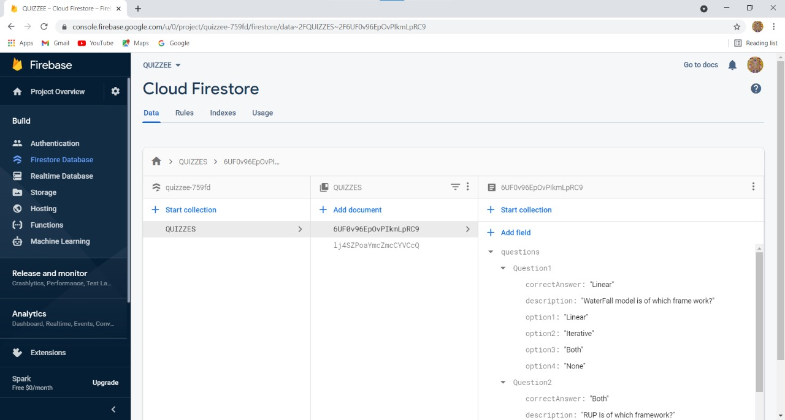
Add update or delete collections(subjects)

Slide 35
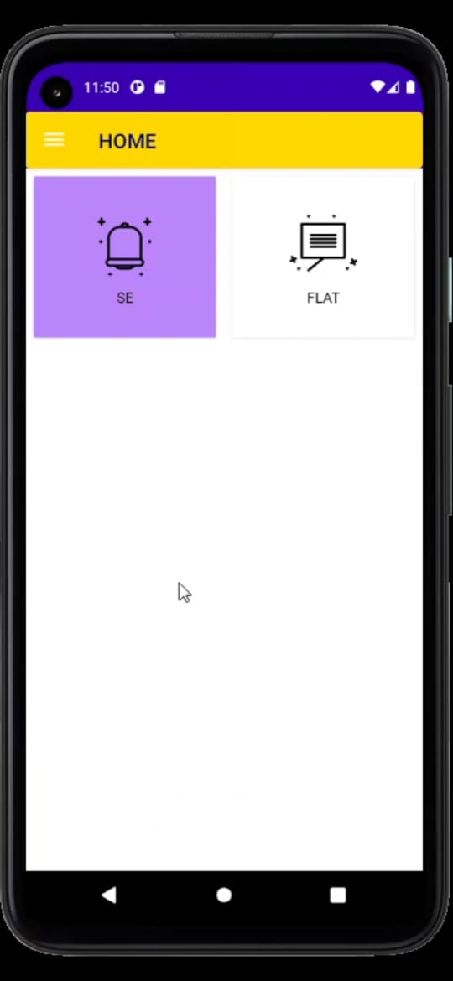
student’s portal:
After we login in our application we get home page where we can choose subject (for which we want to have a quiz).

Slide 36
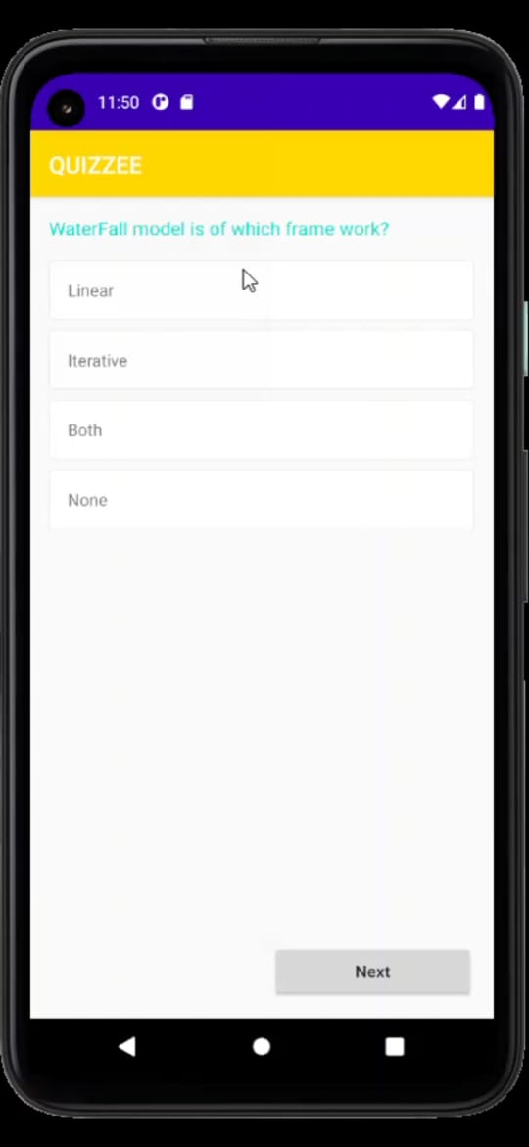
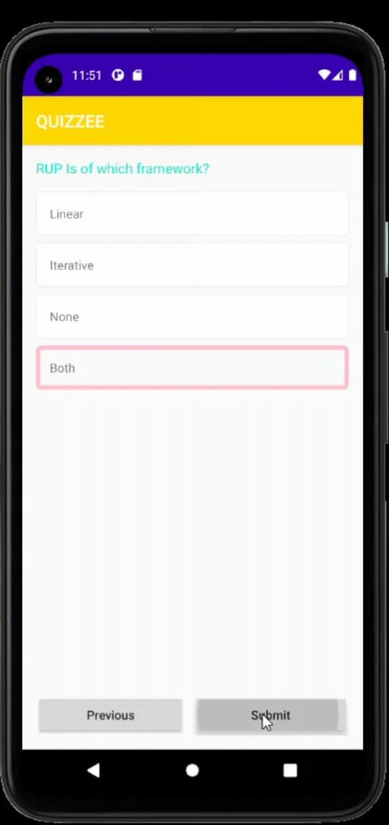
After clicking on respective subject, we will get some questions which are created by admin. There we can select option for the question.
After clicking on Next the next question will appear. If we press previous button, we can also visit the previous question once again.

Slide 37
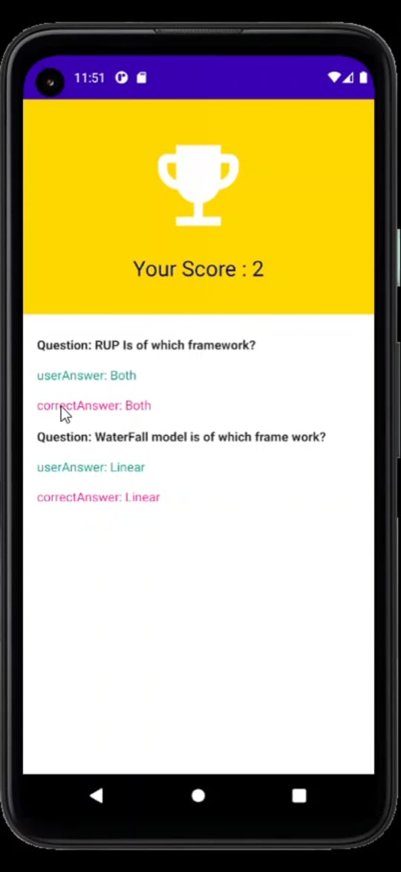
If we computed our quiz if we click on submit then we successfully completed our quiz. Then we get our score card in which we can see our score and correct answers

Slide 38
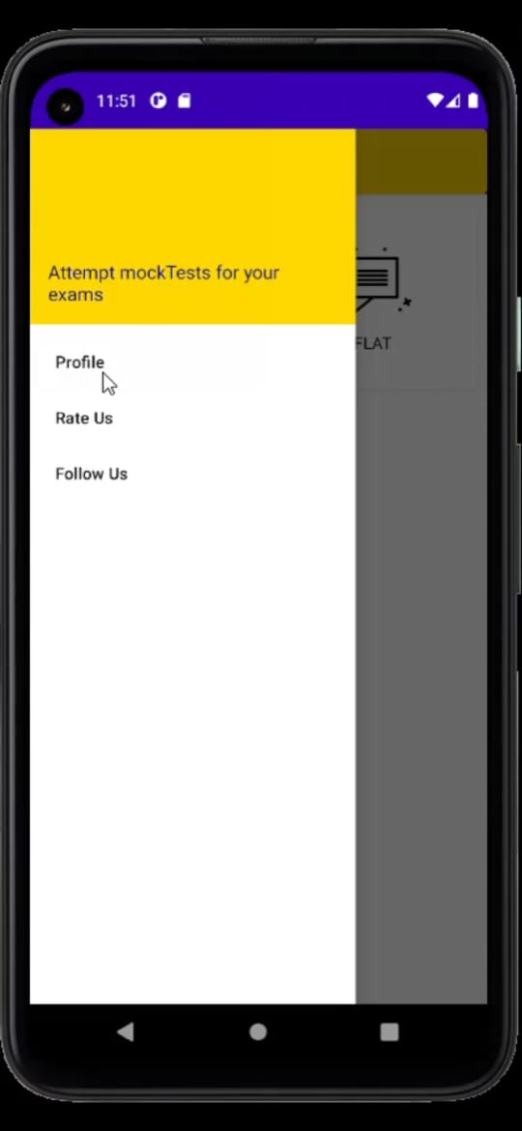
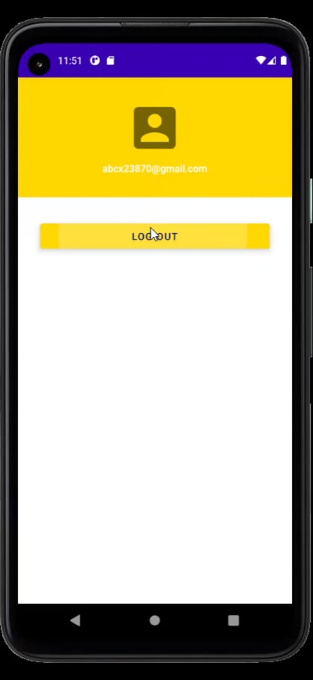
If at all we want to see our profile. In home page there is menu symbol on top. If we click on that we can see the profile.
In case if the user wants to logout that option is available in profile page itself.

Slide 39
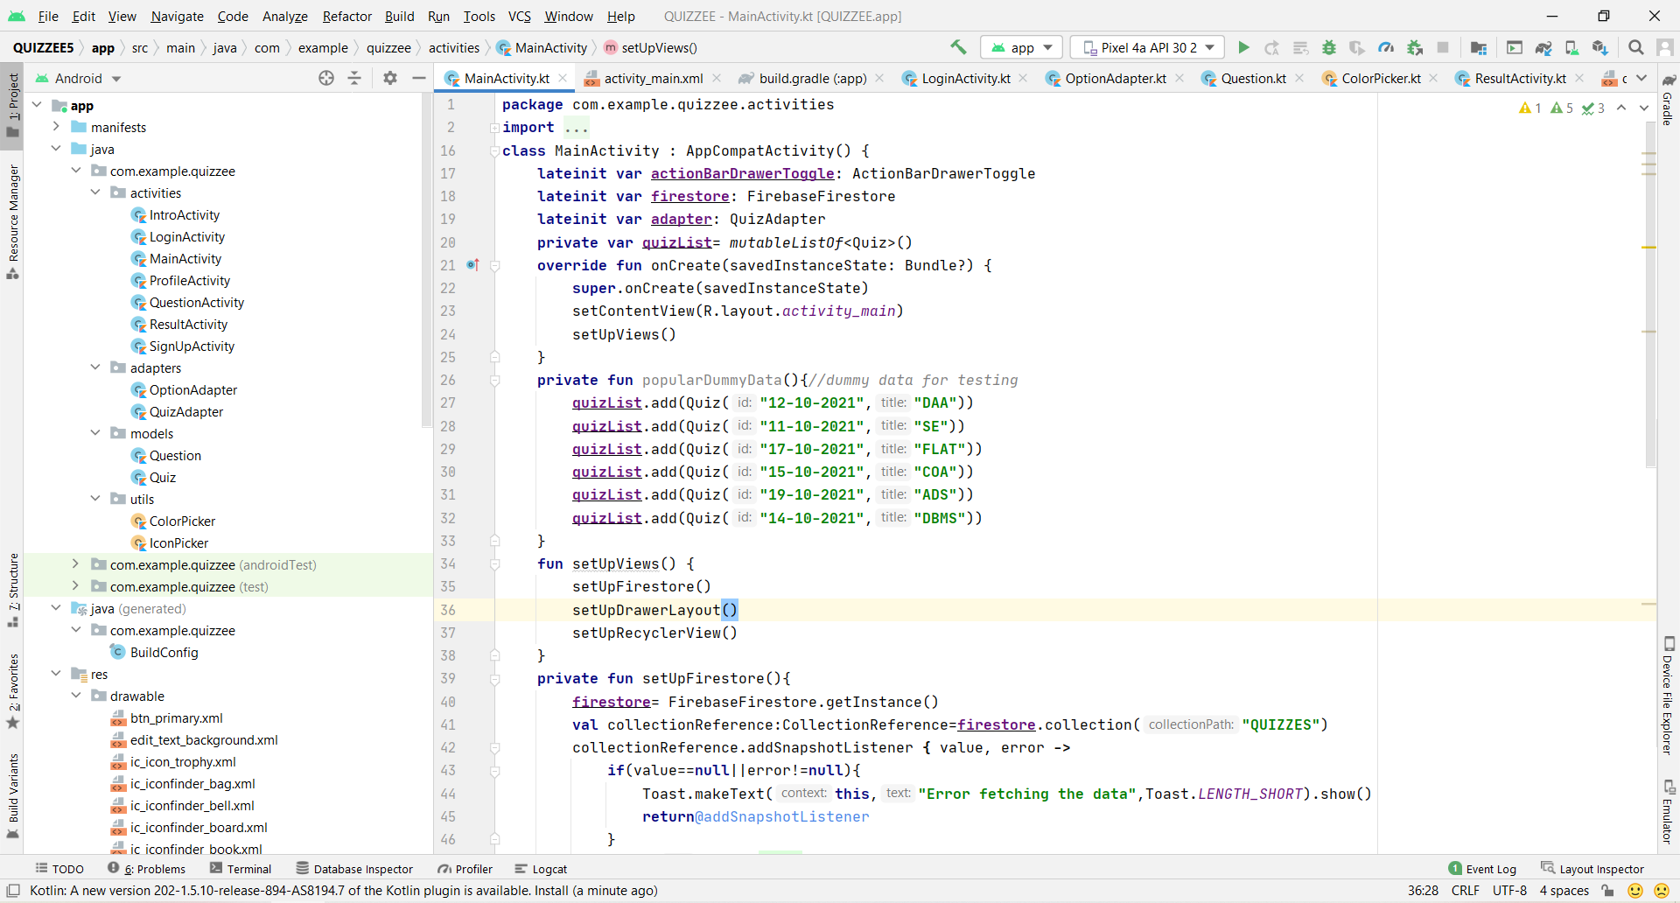

Slide 40
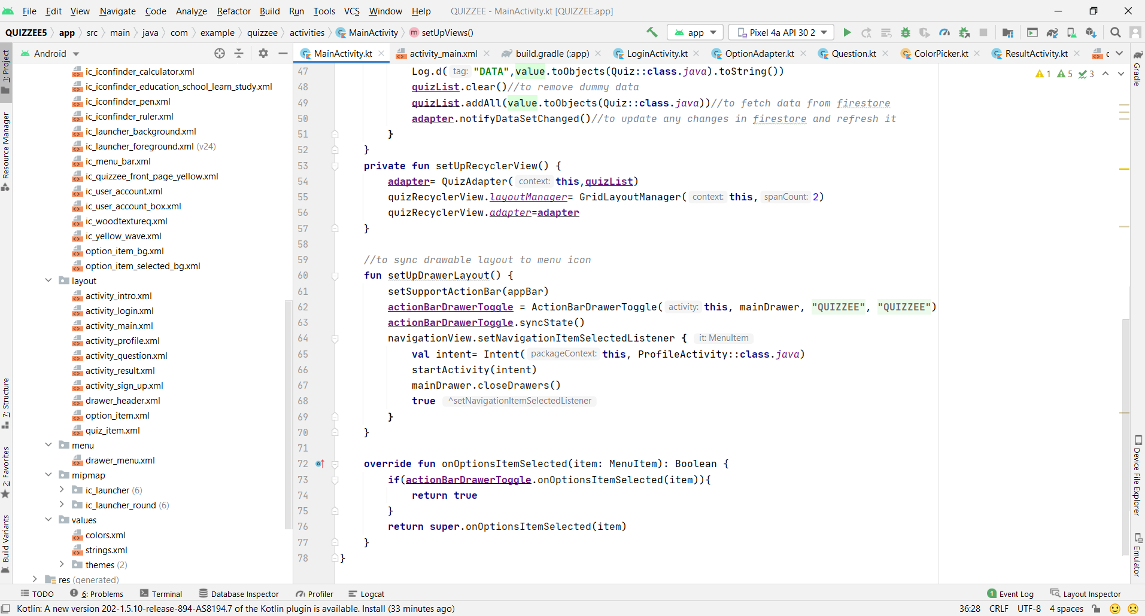

Slide 41
THANK YOU

